Slide 1

Need of NoSQL, Introduction to MongoDB
Java Full Stack Program

Slide 2
What is NoSQL Database?
When individuals say “NoSQL database,” they’re usually referring to every database that isn’t relational. Some people think “NoSQL” means “non-SQL,” while others say it means “not exclusively SQL.” In any case, most people believe that NoSQL databases are libraries that don’t use relational tables to store information.
NoSQL databases store data in a single data format, including a JSON document, rather than the traditional table structure of a relational database. Because this non-relational database architecture doesn’t really need a structure, it can quickly handle massive, often unorganized data sets.
Java Full Stack Program

Slide 3
Why do you need it?
NoSQL is often referred to as “not only SQL” or sometimes a “non-SQL,” which is a database design approach. It allows the user to store and query the data outside the structure of the relational database. This can hold information from relational database management systems (RDBMS), but it does it in a different way than an RDBMS. The choice between a regular and non-relational library is primarily contextual, so it differs based on a use scenario.
NoSQL provides the feasibility of allowing the users the ability to store the information that they have copied. The data is generally stored on several servers that are present locally as well as remotely. The purpose of storing this information is that it is readily available and secure. Furthermore, it makes sure that if certain data is offline, the information on other databases can still be used.
Several companies manage volumes of data at a fast speed, with the ability to process modern website applications as well. NoSQL databases enable speed and flexibility in this period of growing development in the cloud, big data, smartphone, and online applications, making them a popular alternative for their productivity and simplicity of use.
Java Full Stack Program

Slide 4
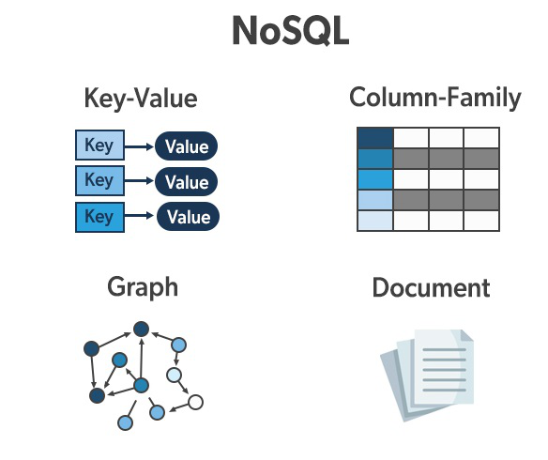
How does NoSQL work?
For storing and organizing data, NoSQL databases employ a number of data structures. These databases are designed for applications that demand massive data, reduced latency, and variable data structures. They do it by loosening a few of the backup and data constraints that conventional databases have. Let us try to understand this with the help of an example.
Java Full Stack Program

Slide 5
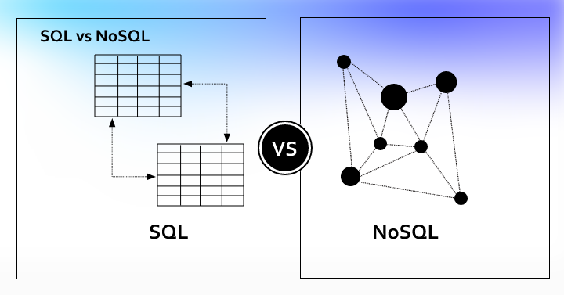
For example, a book record is frequently disassembled (or “normalized”) in a relational database and kept in different tables, with primary key and foreign limitations defining connections. The ISBN, Title Of the book, and Version Number fields are in the Titles record, whereas Author ID and Author Name are in the Publisher’s worktop, and Author ID and ISBN are in the Novelist worktop.
The relational model is intended to allow the network to ensure integrity constraints across database tables while also being standardized to minimize duplication and streamlined for backup.
A book record is often saved as a JSON document in a NoSQL database. The item, ISBN, Book Title, Edition Number, Author Name, and Author ID are all recorded in a written document for every volume. Data is designed for straightforward creation and linear expansion throughout this approach.
Java Full Stack Program

Slide 6
NoSQL Database features that you need to consider
Many current applications, such as smartphones, online, and gaming, demand versatile, accessible, high-performance, and fully capable databases that deliver excellent customer experiences. This is where NoSQL comes in very handy. Therefore, let us see what the features of the NoSQL Database that you need to consider are:
Flexibility: In general, NoSQL databases have flexible structures that allow for rapid and much more iterative improvement. Because of its flexible data format, NoSQL databases are suitable for semi-structured and unstructured information.
Scalability: NoSQL databases are usually designed to expand by employing dispersed hardware groups rather than expanding higher by introducing costly and resilient servers. Like a service software, several cloud services perform these activities behind the lines.
Java Full Stack Program

Slide 7
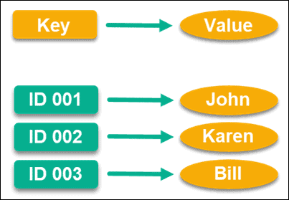
High-performance: NoSQL databases are designed for specific data structures and associated metadata, resulting in faster responsiveness than attempting to provide equivalent functionality using relational databases.
Enhanced functionality: NoSQL databases offer purpose-built data types which offer distinct data models and also a highly functioning Interfaces.
Types of NoSQL Database
Key-Value Databases
In-memory
Graph Database
Wide Column
Document Databases
Java Full Stack Program

Slide 8
Why Should You Use NoSQL Database? What’s the catch?
There are several uses of the NoSQL Database. Therefore, let us see some of the benefits of the NoSQL Database.
NoSQL databases frequently enable developers to customize the data format. They are well suited to contemporary Agile production techniques centred on sprints, fast modifications, and frequent software releases.
It can be time-consuming for a programmer to request a SQL database operator to modify the database structure and afterwards discharge and then reload the data.
NoSQL databases are frequently more suitable for collecting and analyzing organized, semi-structured, and unstructured data in a centralized database.
Java Full Stack Program

Slide 9
NoSQL databases frequently store information in a format comparable to the entities used during applications.
Minimizing the requirement for translation between the format in which the information is stored to the format in which the data appears in code.
As part of its core architecture, NoSQL databases originally were designed to manage large amounts of information.
Whenever SQL databases are utilized to run web-scale applications, there is no additional engineering required. The road to data scalability is well-defined and straightforward.
NoSQL databases are frequently built on a scale-out method, which enables scaling to enormous data volumes far less expensive than the scale-up method used by SQL databases.
Several NoSQL databases utilize a scale-out method, which gives a straightforward way to increase the volume of traffic a library can manage.
Java Full Stack Program

Slide 10
Scale-out structures also provide advantages such as updating or modifying the database structure with no interruption.
Scale-out architecture is among the most cost-effective methods of handling high traffic levels.
NoSQL Use Cases
The structure and kind of NoSQL database individuals select will be determined by just how the business intends to utilize it. There are several specific applications for different forms of NoSQL databases.
1. Managing data connections
A graph-based NoSQL database is generally used to manage the complicated aggregation of information and the links between any of these nodes. This comprises advanced analytics, visualization techniques, fraud detection systems, and social networks, which use diverse data kinds to link individuals.
Java Full Stack Program

Slide 11
2. Low-latency performance
High capacity is required for real-time information handling in games, fitness training apps, and advertising technologies. This infrastructure delivers its most benefit to the user, whether it’s marketplace bidding changes or displaying the best-targeted advertising. Website applications that need throughout NoSQL databases to enable fast response times and handle surges in demand without the latency which disk storage might cause.
What are the examples of NoSQL Databases?
Here are some of the examples of NoSQL Databases:
CouchBase, HBase, Redis, Riak, MongoDB, Cassandra, Amazon SimpleDB, and Lotus Notes.
Java Full Stack Program

Slide 12
Which NoSQL database is the best?
As the requirement for Data Science grows, so does the need for NoSQL database capabilities. Selecting a database might be a simple process if you are a product designer. However, you should be conversant with all NoSQL databases. The following are the top NoSQL database options.
MongoDB: MongoDB is by far the most famous NoSQL document-based database. It is ideally suited for use-cases involving the integration of hundreds of distinct data sources. MongoDB may be used even if you only intend to read and write activities. For example, you may save clickstream data in the database and utilize it for behavioural analysis.
ElasticSearch: If the solution includes a full-text search, the ElasticSearch NoSQL database is employed. It’s utilized by over 3000 businesses, like Udemy, Medium, and StackOverflow. Among the most common use-cases are chatbots that answer the majority of questions.
Java Full Stack Program

Slide 13
DynamoDB: The scalability of Amazon’s NoSQL database is well recognized. DynamoDB is the ideal decision if your products demand a library that can control important basic queries in significant numbers. So whether you are dealing with OLTP workloads, DynamoDB is recommended.
HBase: HBase is an open-source, highly scalable distributed database system. It is an effective method for conveniently storing real-time communications.
Cassandra: Cassandra is one of the most versatile, capable of handling petabytes of data and thousands of simultaneous queries.
Java Full Stack Program

Slide 14
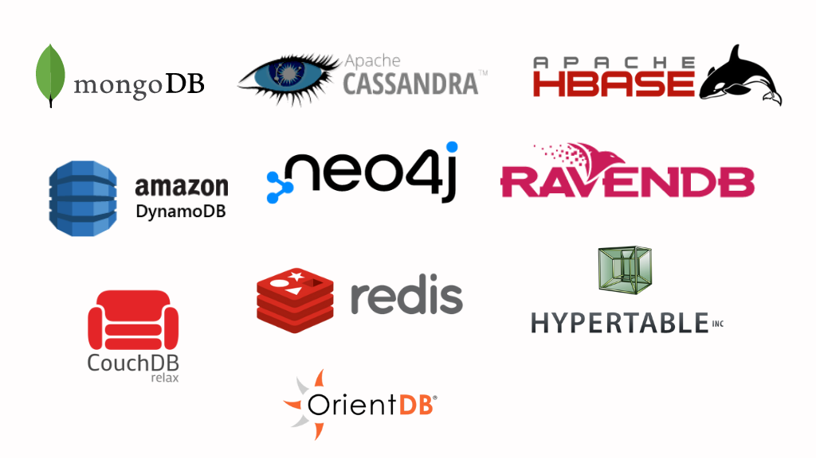
Which NoSQL database is the best?
Java Full Stack Program

Slide 15
How to Query NoSQL Database?
Let us see the steps to Query NoSQL Databases.
We’ll take the example of MongoDB:
In the Collection tab, go to the Data Explorer.
In the left panel in the Data Explorer. Find the list of all the databases.
In the right panel in the Data Explorer, a list of the document will be displayed.
Click on sample_mflix databases on the discussion on the left. A collection of database lists is stated.
Select from the data collection, and a list of twenty results will appear.
Now, in the queue bar, type the name of the data you want to find.
Select Apply. A list of the desired documents will appear.
Java Full Stack Program

Slide 16
Advantages of NoSQL
Can be used as Primary or Analytic Data Source
Big Data Capability
No Single Point of Failure
Easy Replication
No Need for Separate Caching Layer
It provides fast performance and horizontal scalability.
Can handle structured, semi-structured, and unstructured data with equal effect
Object-oriented programming which is easy to use and flexible
NoSQL databases don’t need a dedicated high-performance server
Support Key Developer Languages and Platforms
Simple to implement than using RDBMS
Java Full Stack Program

Slide 17
Disadvantages of NoSQL
No standardization rules
Limited query capabilities
RDBMS databases and tools are comparatively mature
It does not offer any traditional database capabilities, like consistency when multiple transactions are performed simultaneously.
When the volume of data increases it is difficult to maintain unique values as keys become difficult
Doesn’t work as well with relational data
The learning curve is stiff for new developers
Open source options so not so popular for enterprises.
Java Full Stack Program

Slide 18
Summary
NoSQL is a non-relational DMS, that does not require a fixed schema, avoids joins, and is easy to scale.
The concept of NoSQL databases became popular with Internet giants like Google, Facebook, Amazon, etc. who deal with huge volumes of data.
In the year 1998- Carlo Strozzi use the term NoSQL for his lightweight, open-source relational database.
NoSQL databases never follow the relational model it is either schema-free or has relaxed schemas.
NOSQL can handle structured, semi-structured, and unstructured data with equal effect.
CAP theorem consists of three words Consistency, Availability, and Partition Tolerance.
BASE stands for Basically Available, Soft state, Eventual consistency.
Java Full Stack Program

Slide 19

MongoDB
An introduction :
MongoDB, the most popular NoSQL database, is an open-source document-oriented database. The term ‘NoSQL’ means ‘non-relational’. It means that MongoDB isn’t based on the table-like relational database structure but provides an altogether different mechanism for storage and retrieval of data. This format of storage is called BSON ( similar to JSON format).
Java Full Stack Program

Slide 20
A simple MongoDB document Structure:
{
title: 'Geeksforgeeks',
by: 'Harshit Gupta',
url: 'https://www.geeksforgeeks.org',
type: 'NoSQL'
}
SQL databases store data in tabular format. This data is stored in a predefined data model which is not very much flexible for today’s real-world highly growing applications. Modern applications are more networked, social and interactive than ever. Applications are storing more and more data and are accessing it at higher rates.
Relational Database Management System(RDBMS) is not the correct choice when it comes to handling big data by the virtue of their design since they are not horizontally scalable. If the database runs on a single server, then it will reach a scaling limit. NoSQL databases are more scalable and provide superior performance. MongoDB is such a NoSQL database that scales by adding more and more servers and increases productivity with its flexible document model.

Slide 21
RDBMS vs MongoDB:
RDBMS has a typical schema design that shows number of tables and the relationship between these tables whereas MongoDB is document-oriented. There is no concept of schema or relationship.
Complex transactions are not supported in MongoDB because complex join operations are not available.
MongoDB allows a highly flexible and scalable document structure. For example, one data document of a collection in MongoDB can have two fields whereas the other document in the same collection can have four.
MongoDB is faster as compared to RDBMS due to efficient indexing and storage techniques.
There are a few terms that are related in both databases. What’s called Table in RDBMS is called a Collection in MongoDB. Similarly, a Table is called a Document and A Column is called a Field. MongoDB provides a default ‘_id’ (if not provided explicitly) which is a 12-byte hexadecimal number that assures the uniqueness of every document. It is similar to the Primary key in RDBMS.
Java Full Stack Program

Slide 22
Features of MongoDB:
Document Oriented: MongoDB stores the main subject in the minimal number of documents and not by breaking it up into multiple relational structures like RDBMS. For example, it stores all the information of a computer in a single document called Computer and not in distinct relational structures like CPU, RAM, Hard disk, etc.
Indexing: Without indexing, a database would have to scan every document of a collection to select those that match the query which would be inefficient. So, for efficient searching Indexing is a must and MongoDB uses it to process huge volumes of data in very less time.
Scalability: MongoDB scales horizontally using sharding (partitioning data across various servers). Data is partitioned into data chunks using the shard key, and these data chunks are evenly distributed across shards that reside across many physical servers. Also, new machines can be added to a running database.
Java Full Stack Program

Slide 23
Replication and High Availability: MongoDB increases the data availability with multiple copies of data on different servers. By providing redundancy, it protects the database from hardware failures. If one server goes down, the data can be retrieved easily from other active servers which also had the data stored on them.
Aggregation: Aggregation operations process data records and return the computed results. It is similar to the GROUPBY clause in SQL. A few aggregation expressions are sum, avg, min, max, etc
Java Full Stack Program

Slide 24
MongoDB is preferred over RDBMS in the following scenarios:
Big Data: If you have huge amount of data to be stored in tables, think of MongoDB before RDBMS databases. MongoDB has built-in solution for partitioning and sharding your database.
Unstable Schema: Adding a new column in RDBMS is hard whereas MongoDB is schema-less. Adding a new field does not effect old documents and will be very easy.
Distributed data Since multiple copies of data are stored across different servers, recovery of data is instant and safe even if there is a hardware failure.
Java Full Stack Program

Slide 25
Advantages of MongoDB
1. Speed
2. Scalability
3. Availability
4. Flexibility
5. Customer Support
Disadvantages of MongoDB
1. Memory Consumption
2. Joins Functionality
3. Nesting Limitations
4. Indexing Issues
5. Duplication of data
Java Full Stack Program

Slide 26
THANK YOU
Java Full Stack Program

